Slide 1
Radioactivity, Fission, and Fusion
High School Physics
Chapter 13
Notes:
NAD 2023 Standard FFRD1 (Radioactive Decay)
NAD 2023 Standard FFRD2 (Nuclear Fission)
NAD 2023 Standard FFRD3 (Nuclear Fusion)

Slide 2
Credits
This Slideshow was developed to accompany the textbook
  OpenStax High School Physics
    Available for free at https://openstax.org/details/books/physics
    By Paul Peter Urone and Roger Hinrichs
    2020 edition
Some examples and diagrams are taken from the OpenStax College Physics, Physics, and Cutnell & Johnson Physics 6th ed.
Slides created by
Richard Wright, Andrews Academy
rwright@andrews.edu

Slide 3
13-01 Radioactivity
In this lesson you will…
Describe the nucleus of an atom
Explain radioactive decay
Write equations for the three types of radioactive decay
Notes:
OpenStax High School Physics 22.1-2
OpenStax College Physics 2e 30.1-30.2, 31.1-31.4

Slide 4
13-01 Radioactivity
Structure of the atom
  Early 1900’s atom model was “plum pudding”
    Everything spread evening throughout
Rutherford’s Experiment
  Shot α-particles (2 proton, 2 neutrons) at thin gold foil
  Expected to pass mostly straight though with little scattering
    The α-particle has lots of energy and would blow through the “pudding”
  Actually, most passed straight through without scattering
    Some scattered a lot – even straight back

Slide 5
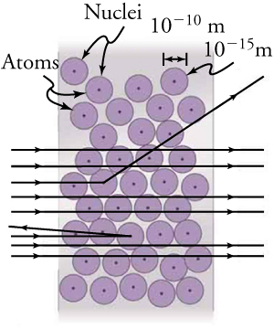
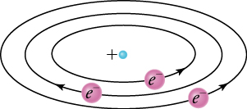
13-01 Radioactivity
Showed the nucleus was very small and much open space around it
Rutherford proposed planetary model of the atom
  Nucleus like sun
  Electrons like planets
  Electrical force like gravity

Slide 6
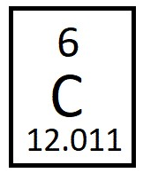
13-01 Radioactivity
Nucleus
  Contains protons and neutrons
    Approximately equal mass
Atomic mass unit (u)
  Neutral carbon-12 = 12 u
  About 1000 times more mass in nucleus than in electrons
  C-12 has 6 protons, 6 neutrons
  Proton and neutrons = 1 u
  1 u = 931.5 MeV/c²
Atomic Number (Z)
  Number of protons in nucleus
  Determines the element
Mass Number (A)
  Number of protons and neutrons

Slide 7
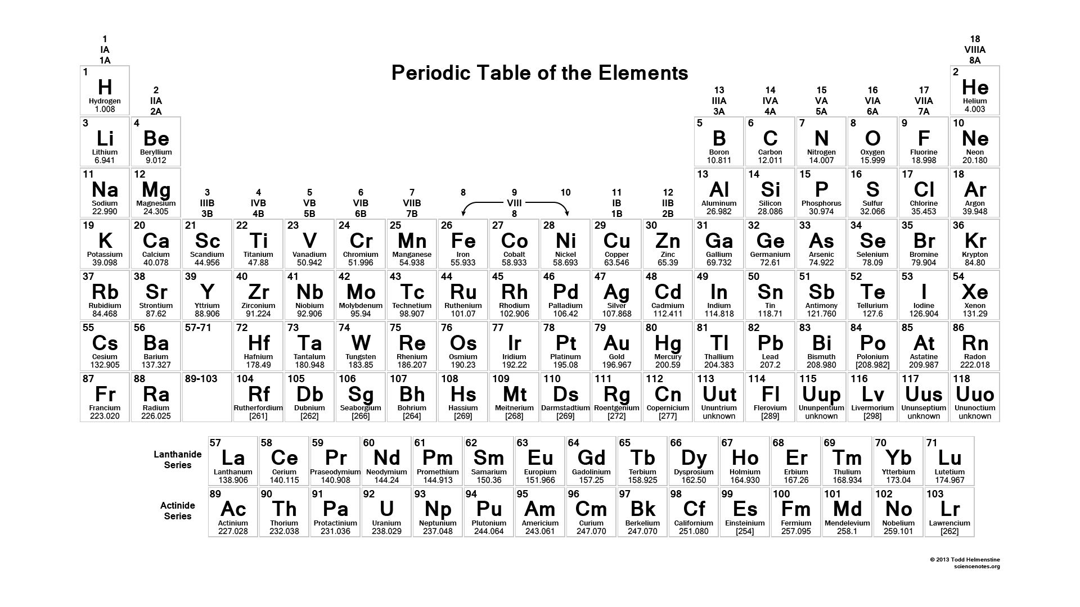
13-01 Radioactivity

Slide 8
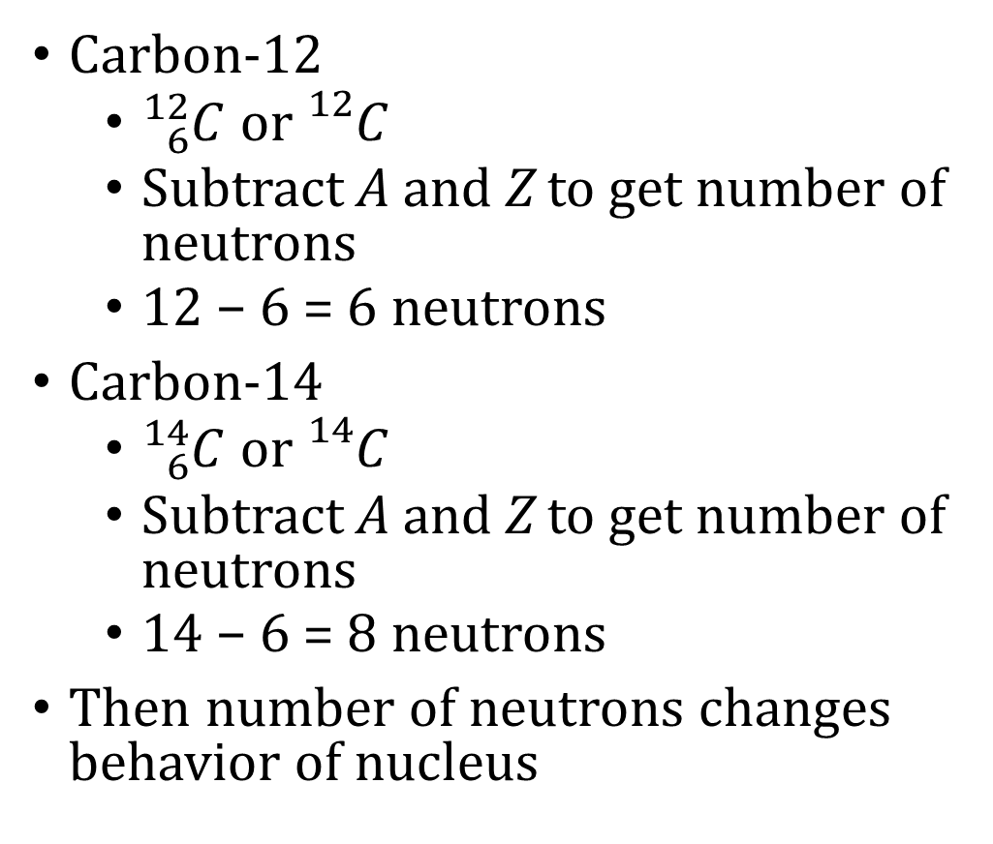
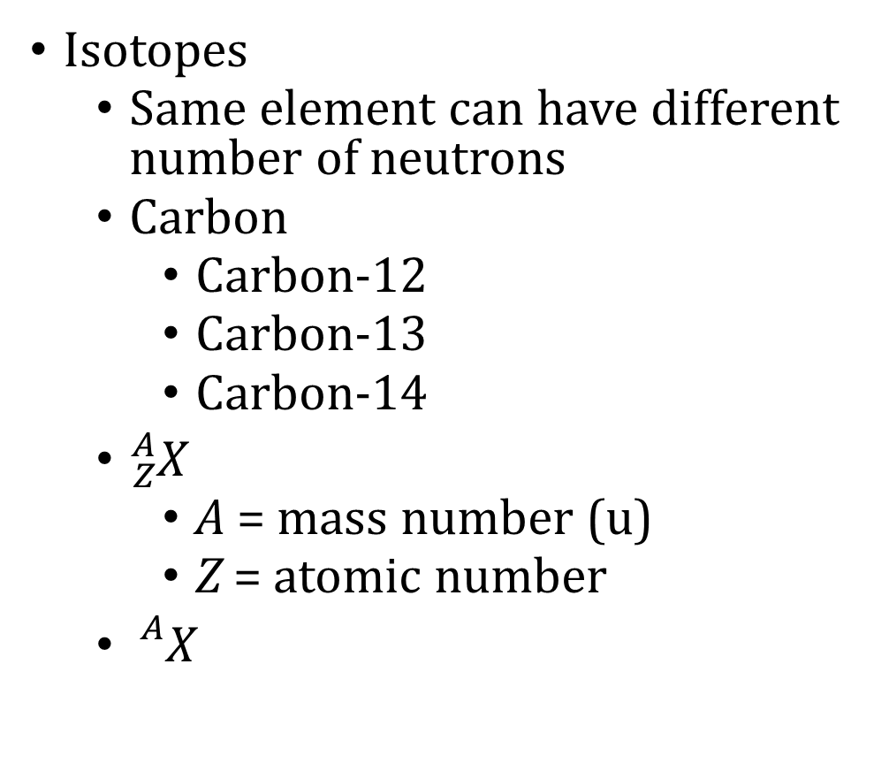
13-01 Radioactivity
Isotopes
  Same element can have different number of neutrons
  Carbon
    Carbon-12
    Carbon-13
    Carbon-14
  ${}_{Z}^{A}X$
    A = mass number (u)
    Z = atomic number
  ${}_{}^{A}X$
Carbon-12
  ${}_{6}^{12}C$ or ${}_{}^{12}C$
  Subtract A and Z to get number of neutrons
  12 − 6 = 6 neutrons
Carbon-14
  ${}_{6}^{14}C$ or ${}_{}^{14}C$
  Subtract A and Z to get number of neutrons
  14 − 6 = 8 neutrons
Then number of neutrons changes behavior of nucleus

Slide 9
13-01 Radioactivity
Large force required to break apart nucleus (it wants to stick together)
Resist putting pushed close to each other
Strong nuclear force
  Holds nucleus together
  Very strong
  Acts at distance less than 10⁻¹⁵ m
Electric forces try to break nucleus apart
When electric forces are more than strong nuclear force, nuclear particles are ejected from nucleus
  Radioactivity
Nucleus wants
  About same number of protons and neutrons
  Smaller radius than strong nuclear force

Slide 10
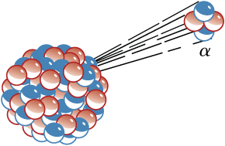
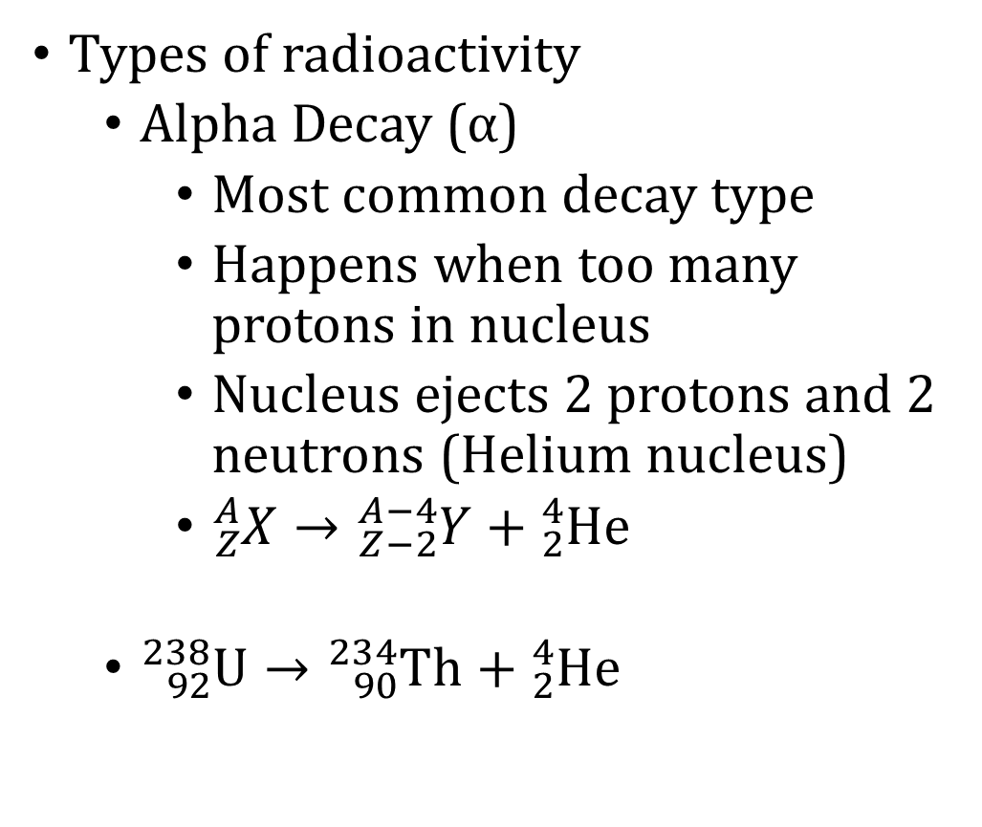
13-01 Radioactivity
Types of radioactivity
  Alpha Decay (α)
    Most common decay type
    Happens when too many protons in nucleus
    Nucleus ejects 2 protons and 2 neutrons (Helium nucleus)
    ${}_{Z}^{A}X→{}_{Z−2}^{A−4}Y+{}_{2}^{4}{He}$
  ${}_{92}^{238}U→{}_{90}^{234}{Th}+{}_{2}^{4}{He}$

Slide 11
13-01 Radioactivity
Notes about α-decay
  During α-decay, the atomic number changes and one element changes into another
  The α-particle quickly gains two electrons and becomes a stable helium atom
    source of all helium on earth
  The total number of particles stays the same
    Law of Conservation of Mass and Energy
      Any change in mass is converted to energy by E = mc²
    Law of Conservation of Charge

Slide 12
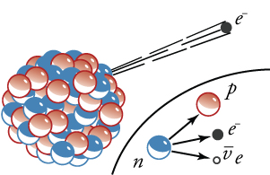
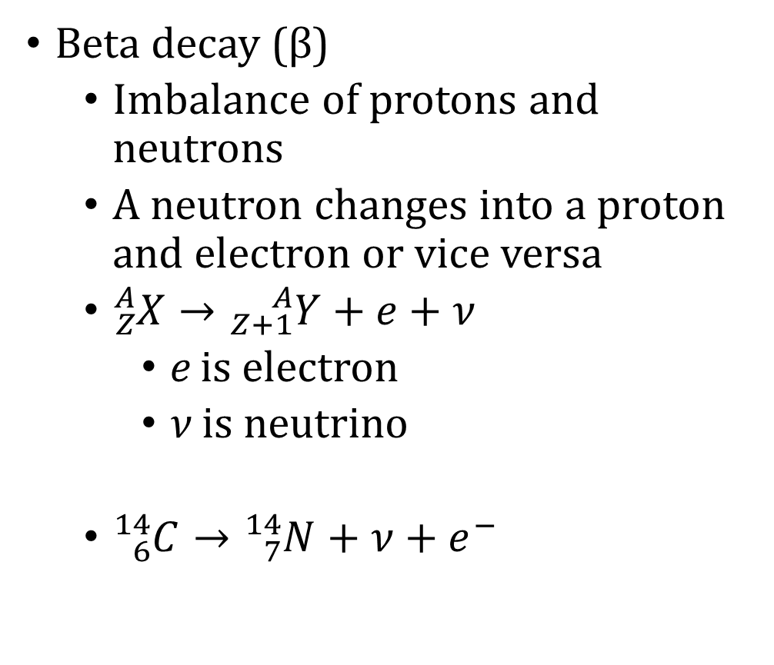
13-01 Radioactivity
Beta decay (β)
  Imbalance of protons and neutrons
  A neutron changes into a proton and electron or vice versa
  ${}_{Z}^{A}X→{}_{Z+1}^{A}Y+e+ν$
    e is electron
    ν is neutrino
  ${}_{6}^{14}C→{}_{7}^{14}N+ν+e^{−}$
Notes:
β⁻ decay a neutron turns into proton and electron and antineutrino
β⁺ decay a proton turns into a neutron and positron and neutrino
Neutrino is tiny neutral particle

Slide 13
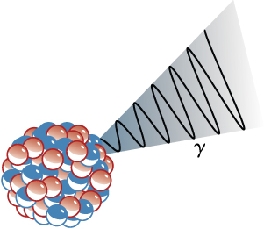
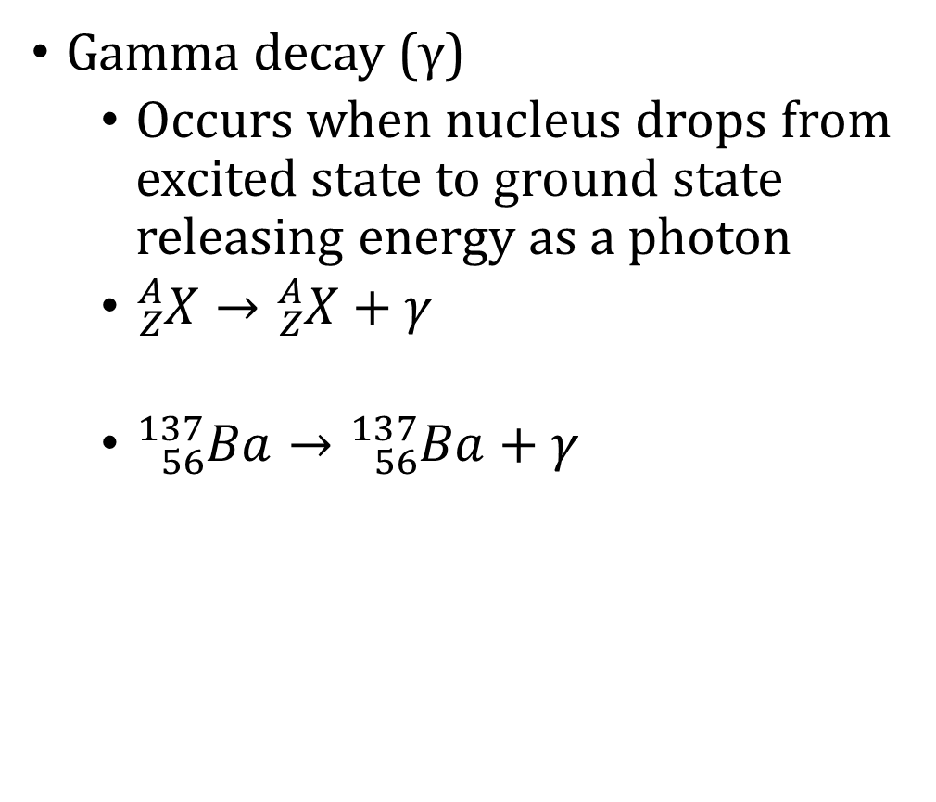
13-01 Radioactivity
Gamma decay (γ)
  Occurs when nucleus drops from excited state to ground state releasing energy as a photon
  ${}_{Z}^{A}X→{}_{Z}^{A}X+γ$
  ${}_{56}^{137}{Ba}→{}_{56}^{137}{Ba}+γ$

Slide 14
13-01 Radioactivity
α-particles are massive (4 u) and have +2 charge, so they quickly interact with matter and can be stopped quickly
  Sheet of paper,
  few cm of air,
  fraction of mm of tissue
β-particles are smaller (mass of e) and −1 charge, so they penetrate farther
  Thin aluminum plate,
  tens of cm of tissue
γ-particles have no mass or charge and barely interact with matter, so they penetrate very far
  Several cm of lead,
  meters of concrete

Slide 15

13-01 Radioactivity
Write the complete decay equation in ${}_{Z}^{A}X$ notation for beta decay producing ${}_{28}^{60}{Ni}$. Refer to the periodic table for values of Z.
Notes:
$${}_{Z}^{A}X→{}_{Z+1}^{A}Y+e+ν$$
Since the atomic number increases by 1, the parent element is one less than Ni which is Co
$${}_{27}^{60}{Co}→{}_{28}^{60}{Ni}+e+ν$$

Slide 16

13-01 Radioactivity
Find the energy emitted in the α decay of ${}_{}^{226}{Ra}$.
Notes:
Start by writing chemical equation
$${}_{88}^{226}{Ra}→{}_{86}^{222}{Rn}+{}_{2}^{4}{He}$$
Now find the change in mass (look the masses up online)
$${}_{}^{226}{Ra}=226.025402 u$$
$${}_{}^{222}{Rn}=222.0175763 u$$
$${}_{}^{4}{He}=4.002602 u$$
$$Δm=m\left(Ra\right)−\left(m\left(Rn\right)+m\left(He\right)\right)$$
$$Δm=226.025402 u−\left(222.0175763 u+4.002602 u\right)=0.0052237 u$$
Convert to energy
$$0.0052237 u\left(\frac{931.5\frac{MeV}{c^{2}}}{1 u}\right)=4.86587655\frac{MeV}{c^{2}}$$
$$E=mc^{2}$$
$$E=\left(4.86587655\frac{MeV}{c^{2}}\right)c^{2}=4.87 MeV$$

Slide 17
13-01 Practice Work
Radioactivity can be harmful to your health, but solving problem is beneficial.
Read
  OpenStax College Physics 2e 31.5
  OR
  OpenStax High School Physics 22.3

Slide 18
13-02 Radiometric Dating
In this lesson you will…
Understand half-life
Use radiometric dating
Notes:
OpenStax High School Physics 22.3
OpenStax College Physics 2e 31.5

Slide 19
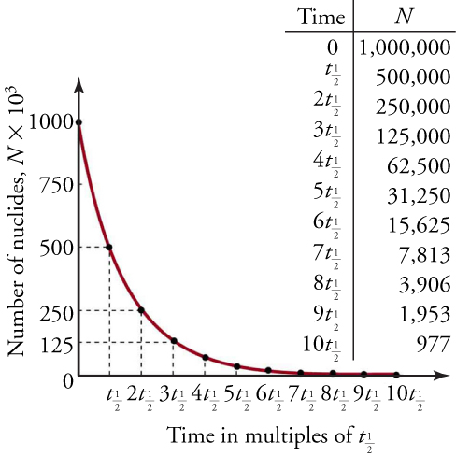
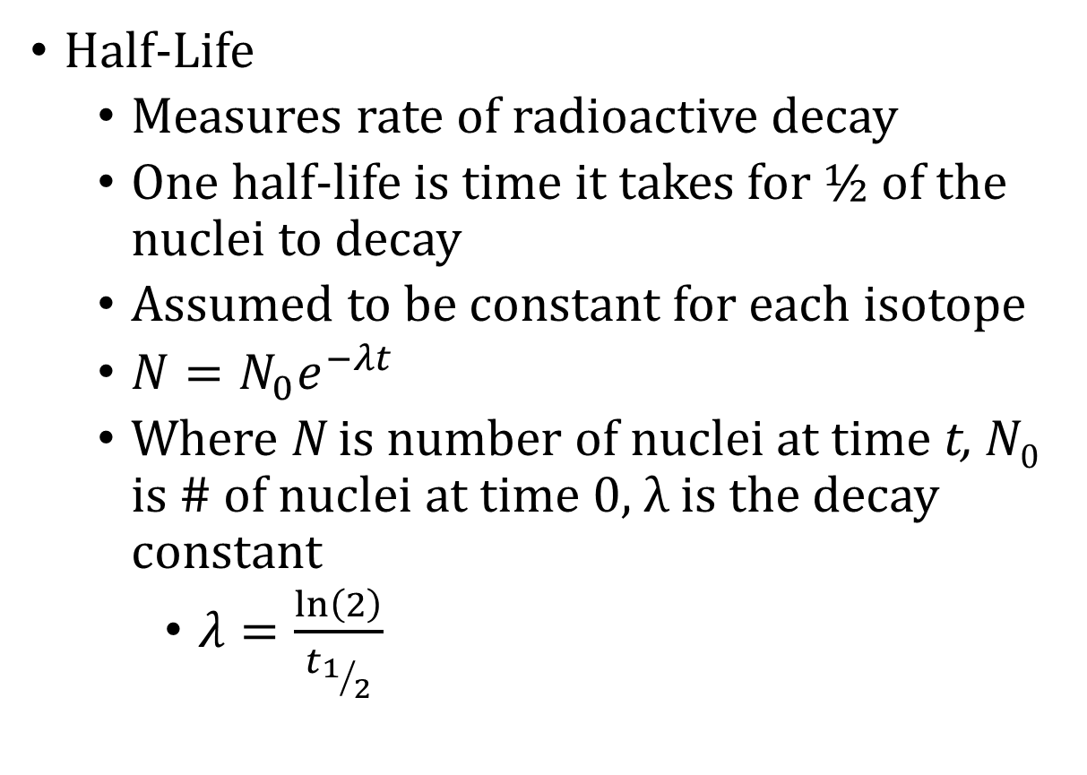
13-02 Radiometric Dating
Half-Life
  Measures rate of radioactive decay
  One half-life is time it takes for ½ of the nuclei to decay
  Assumed to be constant for each isotope
  $N=N_{0}e^{−λt}$
  Where N is number of nuclei at time t, N₀ is # of nuclei at time 0, λ is the decay constant
    $λ=\frac{\ln\left(2\right)}{t_{1/2}}$

Slide 20
13-02 Radiometric Dating
Radioactive Dating
  Method used to date minerals
  Assumptions
    Amount of starting material known
    No radioactive material enters or leaves the mineral
    No new radioactive material created by other sources such as cosmic rays or other radioactive reactions
    Decay rate is constant

Slide 21
13-02 Radiometric Dating
Carbon-14 has a half-life of 5730 years. If there was originally 20 grams, but only 15 grams remains. How much time elapsed?
Notes:
$$λ=\frac{\ln\left(2\right)}{t_{1/2}}$$
$$λ=\frac{ln\left(2\right)}{5730}=1.21×{10}^{−4} /yr$$
$$N=N_{0}e^{−λt}$$
$$15 g=\left(20 g\right)e^{−\left(1.21×{10}^{−4}\frac{}{yr}\right)t}$$
$$0.75=e^{−\left(1.21×{10}^{−4} \backslash yr\right)t}$$
$$ln\left(0.75\right)=−\left(1.21×{10}^{−4}\frac{}{yr}\right)t$$
$$t=2378 yrs$$

Slide 22
13-02 Radiometric Dating
What is the half-life of technetium-99 if 20% decays in about 488000 years?
Notes:
Amount remaining = 100% − 20% = 80%
$$N=N_{0}e^{−λt}$$
$$\frac{N}{N_{0}}=e^{−λt}$$
$$0.80=e^{−λ\left(488000 yr\right)}$$
$$\ln\left(0.80\right)=−λ\left(488000 yr\right)$$
$$λ=4.57×{10}^{−7}\frac{}{yr}$$
$$λ=\frac{\ln\left(2\right)}{t_{1/2}}$$
$$4.57×{10}^{−7}\frac{}{yr}=\frac{\ln\left(2\right)}{t_{1/2}}$$
$$t_{1/2}=\frac{\ln\left(2\right)}{4.57×{10}^{−7}\frac{}{yr}}=1.52×{10}^{6} yr$$

Slide 23
13-02 Practice Work
Talking about radioactivity is a sure way to get a date.
Read
  OpenStax College Physics 2e 32.6
  OR
  OpenStax High School Physics 22.4

Slide 24
13-03 Nuclear Fission
In this lesson you will…
Explain nuclear fission
Find the energy from a fission reaction
Notes:
OpenStax High School Physics 22.4
OpenStax College Physics 2e 32.6

Slide 25
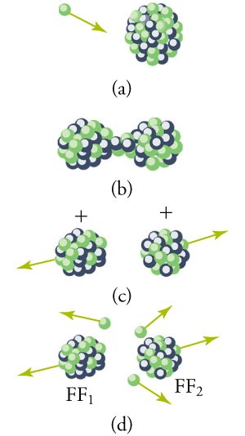
13-03 Nuclear Fission
Fission
  Splitting of a nucleus
  Releases a lot of energy
  An unstable nucleus can naturally decay with α or β radiation, but can take a long time
  Purposely done by hitting a large nucleus with a neutron (β radiation)

Slide 26
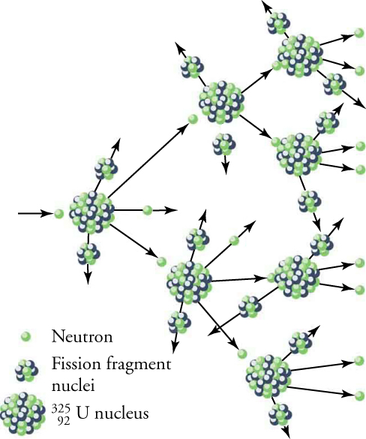
13-03 Nuclear Fission
Chain reaction
  When the nucleus splits it releases free neutrons
  Those can hit other nuclei and split them
  Critical mass – Minimum amount of fissable material necessary to sustain fission chain reaction
  Number of fission reactions increases exponentially
    bomb

Slide 27
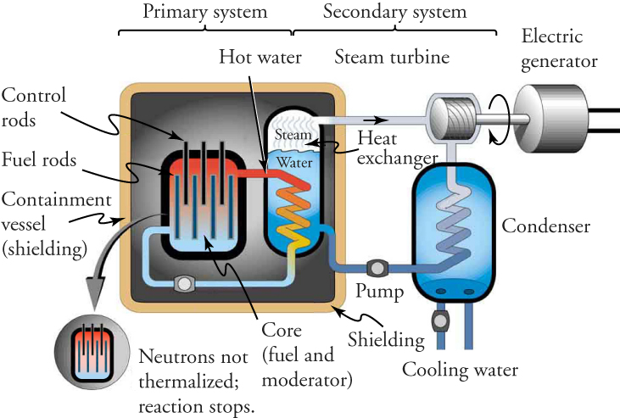
13-03 Nuclear Fission
Nuclear Reactor
  To keep a nuclear fission reaction from becoming a bomb, slow down the neutrons with water
  Fuel rods contain Uranium
  Control rods absorb neutrons
    Insert control rods to slow reaction
  Fission reaction heats water
  Steam turns turbines to make electricity
  Cool water goes back to be heated

Slide 28
13-03 Nuclear Fission
Energy from Fission
  The mass of the products of fission is less than parent nucleus
  That mass is converted to energy by E = mc²
  Average fission reaction produces about 200 MeV of energy

Slide 29

13-03 Nuclear Fission
Find the energy released in the fission of uranium-235 given in the equation
${}_{0}^{1}n+{}_{92}^{235}U→{}_{56}^{141}{Ba}+{}_{36}^{92}{Kr}+3 {}_{0}^{1}n$
Masses
  Neutron: 1.008665 u
  ²³⁵U: 235.0439299 u
  ¹⁴¹Ba: 140.9144035 u
  ⁹²Kr: 91.926173094 u
Notes:
Find change in mass:
$$Δm=\left(1.008665 u+235.0439299 u\right)−\left(140.9144035 u+91.926173094 u+3\left(1.008665 u\right)\right)=0.186023306 u$$
Covert the mass into energy
$$0.186023306 u\left(\frac{931.5\frac{MeV}{c^{2}}}{1 u}\right)=173.28\frac{MeV}{c^{2}}$$
$$E=mc^{2}$$
$$E=\left(173.2807095\frac{MeV}{c^{2}}\right)c^{2}=173.2807095 MeV$$
The actual measurements give 202.5 MeV due to gamma radiation and decay of the neutrons

Slide 30
13-03 Nuclear Fission
Calculate the amount of energy produced by the fission of 1.00 kg of ²³⁹Pu, given the average fission reaction of ²³⁹Pu produces 211.5 MeV. The atomic mass of ²³⁹Pu is 239.05 u.
This is a lot of energy. Over 650,000 gallons of gasoline or enough to run an average US home for 2255 years
Notes:
Start by finding the number of atoms of ²³⁹Pu in 1.00 kg.
$$\left(\frac{1000 g}{239.05\frac{g}{mol}}\right)\left(\frac{6.022×{10}^{23} atoms}{1 mol}\right)=2.519×{10}^{24} atoms of {}_{}^{239}{Pu}$$
Find the energy
$$\left(2.519×{10}^{24} atoms\right)\left(211.5\frac{MeV}{atom}\right)\left(\frac{1×{10}^{6} eV}{1 MeV}\right)\left(\frac{1.60×{10}^{−19} J}{1 eV}\right)=8.525×{10}^{13} J$$
This is a lot of energy. Over 650,000 gallons of gasoline or enough to run an average US home for 2255 years

Slide 31
13-03 Practice Work
How many practice work assignments could be written with the energy of 1 gram of fusible material?
Read
  OpenStax College Physics 2e 32.5
  OR
  OpenStax High School Physics 22.4

Slide 32
13-04 Nuclear Fusion
In this lesson you will…
Explain nuclear fusion
Find the energy from a fusion reaction
Notes:
OpenStax High School Physics 22.4
OpenStax College Physics 2e 32.5

Slide 33
13-04 Nuclear Fusion
Nuclear Fusion
  Combining two nuclei into one
  Releases a lot of energy
  Fission breaks apart large nucleus
  Fusion combines small nuclei
For nuclei less than iron,
  Nuclear forces holding the nucleus together are stronger than the electrical force pushing it apart
  Strong nuclear force does work when adding more nucleons to small nuclei releasing energy
  For elements higher than iron, energy must be added for fusion
    Stars can only create elements up to iron
    There is debate amongst atheists about where heavier elements come from

Slide 34
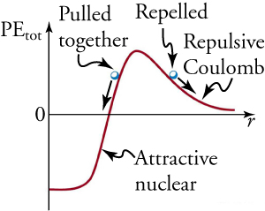
13-04 Nuclear Fusion
Why fusion is difficult
  The parent products must have enough kinetic energy to overcome the electrical force forcing the positive protons apart
    Use high temp to make the KE
  Once the parent elements are close enough the strong nuclear force does work pulling the pieces together into one nucleus releasing energy

Slide 35
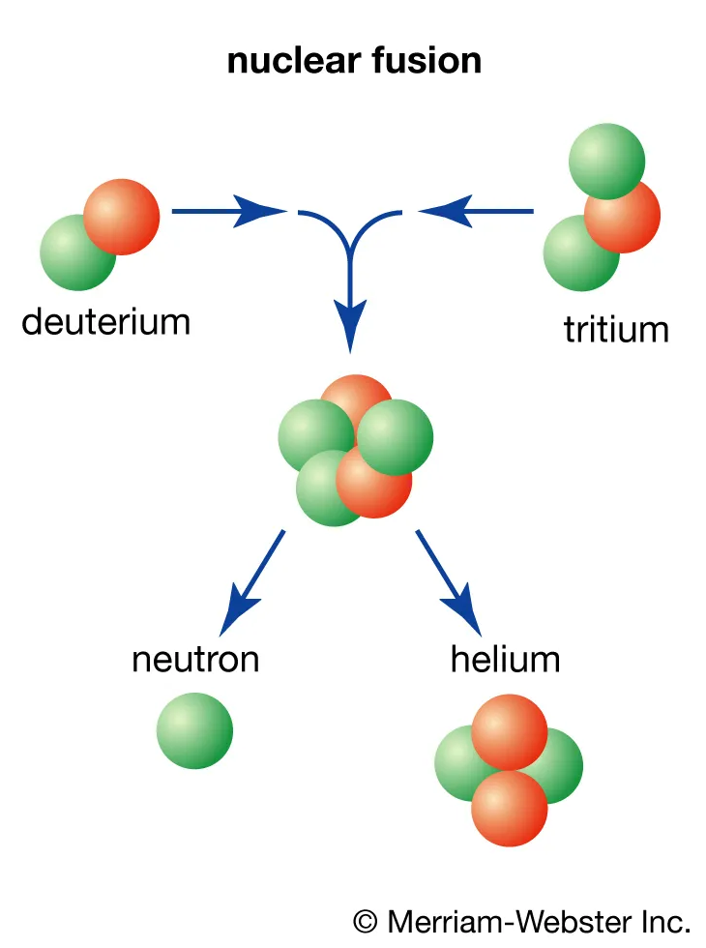
13-04 Nuclear Fusion
Process to combine H to make He
¹H + ¹H → ²H + e⁺ + ν_{e} (×2)
  0.42 MeV
¹H + ²H → ³He + γ (×2)
  5.49 MeV
³He + ³He → ⁴He + ¹H + ¹H
  12.86 MeV
Overall cycle
2e⁻ + 4 ¹H → 4 ⁴He + 2ν_{e} + 6γ
Releasing 26.7 MeV
Notes:
e⁺ is positron
ν_{e} is a electron neutrino
The two electrons combine with two positrons to annihilate and produce 6 gamma rays

Slide 36
13-04 Nuclear Fusion
Nuclear Weapons
Fission Bomb
  Essentially subcritical masses are forces together by a conventional explosion
  Forms a critical mass that builds energy exponentially until it explodes
  10-20 kilotons
  Like bombs dropped on Hiroshima and Nagasaki
Fusion Bomb
  Fission bomb explodes next to lithium deuteride
  γ rays heat and compress the lithium
  The lithium undergoes fission to make ³H and ⁴He
  The hydrogen then fuses to make more He
  This is all surrounded by a uranium shell that reflect neutrons back into the bomb to keep the reaction going

Slide 37
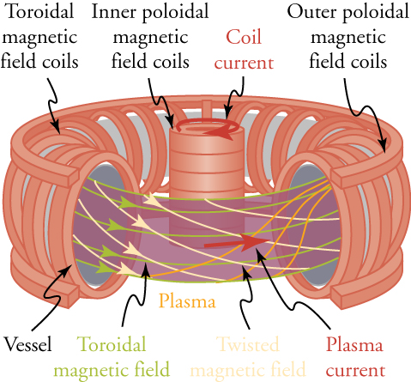
13-04 Nuclear Fusion
Fusion Reactor
  Better than fission
    Plentiful fuel
    Products are safe
    More energy released
  Deuterium and tritium injected into vessel with high temp and pressure
  EM field turn the hydrogen into plasma
  H fuses into He
  High-velocity neutrons released are unaffected by EM field
  Neutrons strike sides of vessel creating heat, makes steam, turns turbine

Slide 38
13-04 Nuclear Fusion
How much energy is released from the fusion of 1.00 kg of hydrogen?
This is enough energy to run an US home for 16,900 years
Notes:
4 hydrogen produce 26.7 MeV
$$\frac{26.7 MeV}{4}=6.675\frac{MeV}{atom}$$
Find number of H atoms in 1.00 kg
$$\left(\frac{1000g}{1.008\frac{g}{mol}}\right)\left(\frac{6.022×{10}^{23} atoms}{1 mol}\right)=5.97×{10}^{26} atoms$$
Multiply to get total energy
$$\left(5.97×{10}^{26} atoms\right)\left(\frac{6.675 MeV}{1 atom}\right)\left(\frac{1×{10}^{6} eV}{1 MeV}\right)\left(\frac{1.60×{10}^{−19} J}{1 eV}\right)=6.38×{10}^{14} J$$

Slide 39
13-04 Practice Work
Fuse graphite with paper to write the results of this practice work.

